Slide 1


Technical vs. Prezi Presentations
Exploring the differences and leveraging the right format for impactful communication.

Slide 2

Purpose of the Presentation
1
Communicate Information
2
Engagement
Convey key concepts clearly and concisely.
Ensure audience involvement for effectiveness.
3
Action Inspiring
Drive decisions and actions post-discussion.

Slide 3


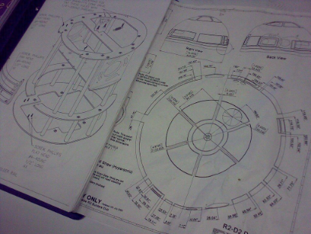
Technical Presentations
Data-Driven
Detailed
Professional Format
Focused on figures and analytics.
Rich in specialized information.
Traditional, structured layout.

Slide 4
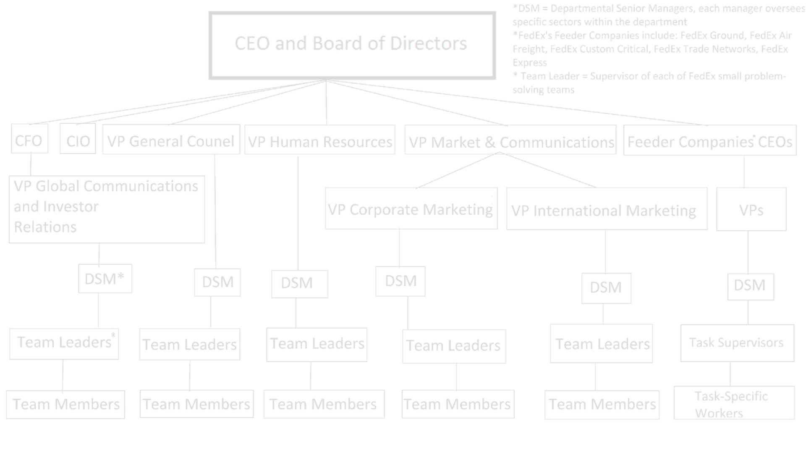
Definition and Characteristics
Structured
In-Depth
Objective-Oriented
Strict format with linear progression.
Covers comprehensive, technical content.
Targets conveyance of precise information.

Slide 5
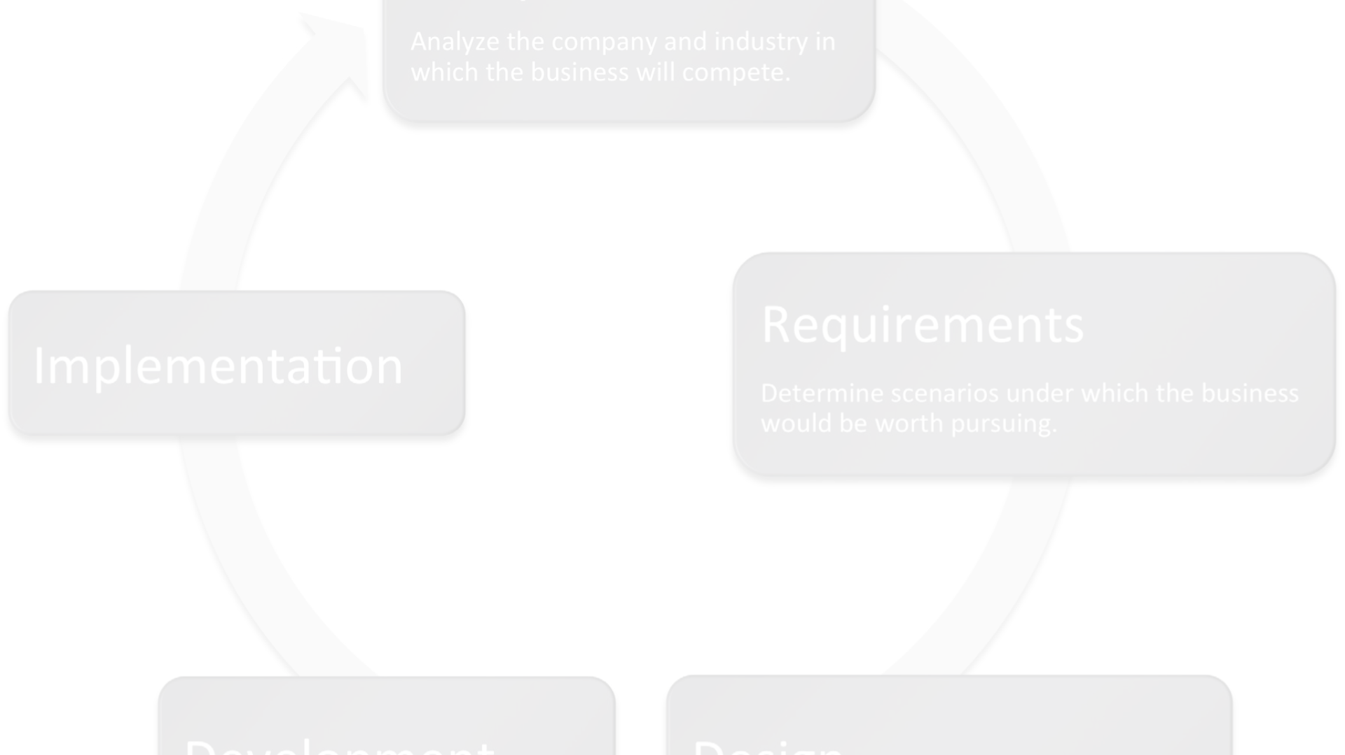
Advantages and Disadvantages
1
Pros
Clear, focused, expert-level detail.
2
Cons
Can be complex, less engaging.

Slide 6
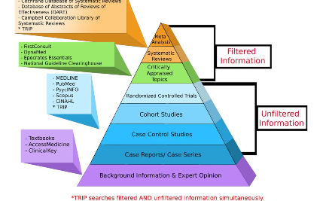

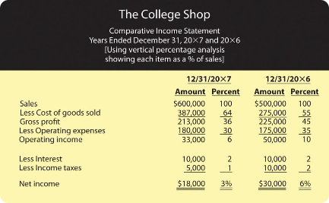
Examples and Case Studies
Healthcare Study
Engineering
Finances
Impact of data on patient outcomes.
Innovations in structural design.
Annual reports and market trends.

Slide 7




Prezi Presentations
Dynamic
Energetic and stylish designs.
Flexible
Non-linear, interactive paths.
Engaging
Visual storytelling for audience.

Slide 8
Definition and Characteristics
Creative Layouts
Encourage creative storytelling.
Zoom Features
Focuses on details within the big picture.
Collaborative
Allows real-time editing by multiple users.

Slide 9

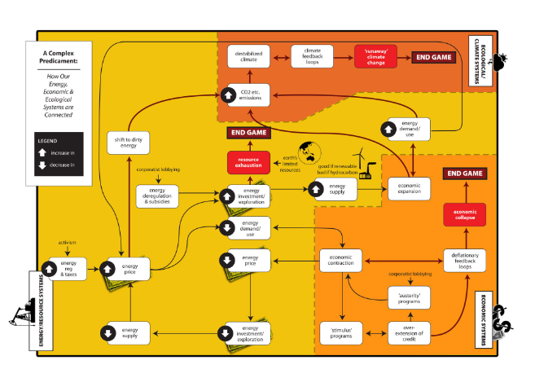
Advantages and Disadvantages
Pros
Cons
Visually compelling, interactive experience.
Steep learning curve, dependency on technology.

Slide 10
Examples and Case Studies
3
250+
Success Stories
Templates
Innovative Prezi pitches that won deals.
Various industries adopting Prezi.

